Slide 1

The doomed patient of wwii
By
James Hellman

Slide 2
Inspiration Cards:
Surgeon (Used in mechanic)
Roller Coaster (Used in lore)
Secret (Used in lore)

Slide 3
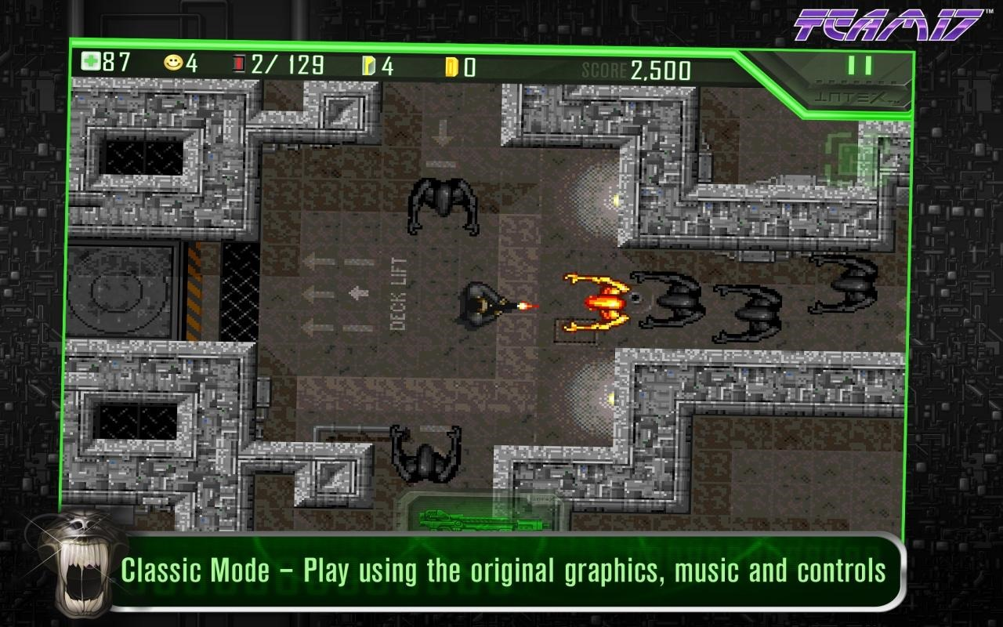
Intended Aesthetic:
A horror/thriller based game it will portray the darker side of WWII, where German doctors were experimenting on POW’s to create new more effective mean of mass destruction.
A top down 2D game with simplistic art.
An example of this is found in Alien
Archives released in 1991

Slide 4






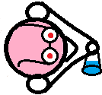





Mechanic:
Puzzle Thriller.
As you try to escape you have to find your way out of the randomly generated maze.

Slide 5
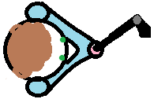
The player:
Her we see the player without and with a weapon respectively.
You will find weapons around the level to use.

Slide 6
The Doctor and his card:
The doctors roam most of the rooms in the hospital,
You as the player must acquire a weapon to beat a key card out of them.
Watch out though, if your caught without a weapon the doctors will preform experiments on you resulting in an unknown change to your character.

Slide 7
The guard:
The guards patrol the corridors of the hospital ensuring no patient escapes.
If you run into a guard you will be returned to your cell and will have to attempt the escape without the creature resetting.

Slide 8

The creature:
Something has escaped its cell. It has no name and will not be stopped.
As you progress through each level the creature will slowly make its way through the level directly to the end.
If your caught by the monster you must repeat the previous level, unless you have obtained the sure from that level.

Slide 9
Potions:
The German doctors have created interesting concoctions in this place, grab one and you will receive an effect.
Yellow: Makes you Invisible for a short duration
Green: makes you run faster for a short duration
Rainbow: Gives you a random boost
Beware!! These potions have no affect on the
Creature, if your invisible it will see you,
if you run faster it will.

Slide 10
The cure:
The doctors have done something to you, you must obtain the cure.
If you do acquire the cure and get caught by the creature you do not have to repeat the last level.

Slide 11
The Doors:
There are two types of doors regular and reinforced respectively.
Regular doors can be opened with little effort.
Reinforced doors require a key card to get through and these can only be obtained from a doctor.

Slide 12
Start
Exit
The Cure
Creature Start

Slide 13

Start
Exit

Slide 14
Getting a key-card.

Slide 15
Title Concept:
Title: The Escapist Patient of WWII.
Concept: A game where the patient(the player), starts in a secret experimental hospital located under a theme park. Filled with German guards and surgeons and a mutated creature. The aim of the game is to escape the crazed hospital without getting caught. You can attack the surgeons but not the guards, plus if you run into the creature you must repeat the previous level.

Slide 16
Why is it fun?:
As the player having the creature constantly chasing you provides a small thrill, and having to sneak around without getting caught brings a certain level of skill to the game.
The challenge of the game will be a time based so they will have to be decisive about where they go otherwise they might waist valuable time.

Slide 17
Market/Target Audience:
Casual gamers
Age rating will be 15+
For gamers that prefer a challenge

Slide 18
Unique Selling Points:
A classic arcade thriller, using PCG to create the content levels.
The game has a unique mechanic where if you don’t collect the cure you risk having to repeat the last level.

Slide 19
Scope:
Yes?
Depending on design changes I would say that the scope is not too unreasonable.
If a PCG algorithm can be written, we can make many levels without the need for designing each level.

Slide 20
Thanks for listening
Any Questions?

